Slide 1
Causal Inference and ML:
Simpson’s Paradox in Drug Recovery
Analyze the effect of a drug on recovery and demonstrate Simpson’s paradox caused by confounding variables
Polina Tohoieva
June 1, 2026
Github Repository: https://github.com/polinato/simpsons-paradox-drug-recovery

Slide 2
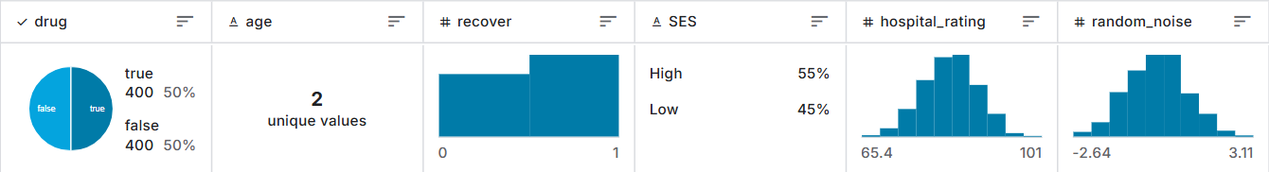
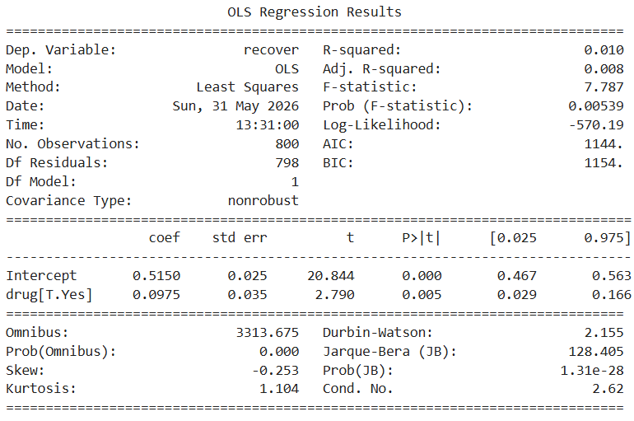
Simpson’s Paradox in Drug Recovery
Dataset
800 patients
Treatment: drug (1/0)
Outcome: recover (1/0)
Confounders: age, SES, hospital_rating
Naive Model
not causal
The drug appears to increase recovery rates by about 10%
Polina Tohoieva

Slide 3

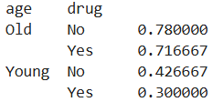
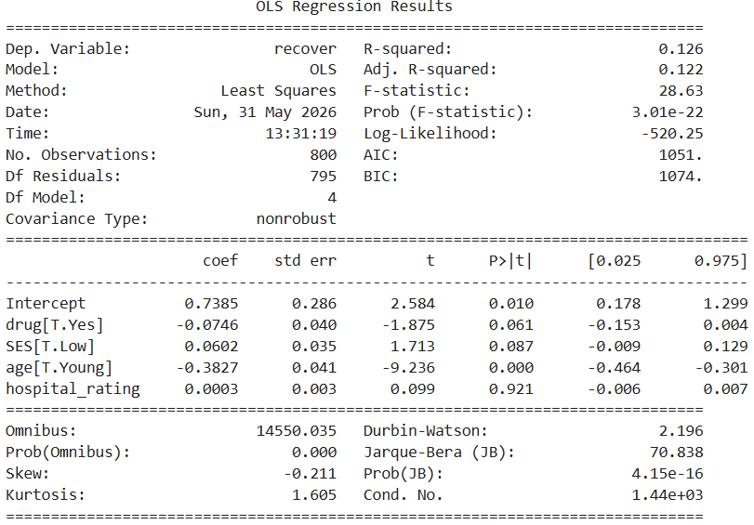
Simpson’s Paradox in Drug Recovery
Cause
Within each group, the drug reduces recovery
Treatment imbalance
Drug is mostly given to Old patients
Old patients have higher recovery rates
The drug group looks artificially better in total
Controlled model
After controlling for age, SES, and hospital rating, the estimated effect of the drug becomes negative

